Slide 1
Advanced Games Engine Creation
Various Techniques

Slide 2
Introduction
Over the past 8 weeks we have looked at many techniques for 3D representation and rendering
Today and next week we will look at a few more needed for the assignment
  See assignment rubric on Blackboard
Today:
  Displaying text (HUD), animation and manipulation of scene objects, collision detection, rendering multiple objects, hierarchical scene graphs
  Next week: Optimisation techniques

Slide 3
Drawing text on the screen
often want to draw text on the screen
drawing text in OpenGL is not straightforward
ideally we would load a sprite sheet of character images to render
we will take a shortcut and use a glut method to render characters
a method to output a string:
  void GameScreen::OutputLine(float x, float y, string text)
  {
  glRasterPos2f(x, y); // where to start drawing
  for (int i = 0; i < text.size(); i++) {
  glutBitmapCharacter(GLUT_BITMAP_HELVETICA_12, text[i]);
  }
  }

Slide 4
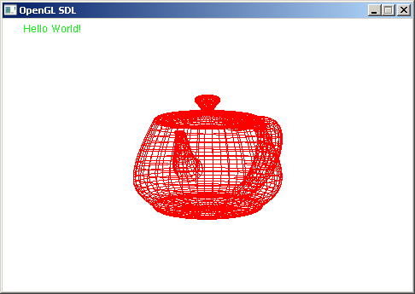
Rendering a HUD
// first render the teapot, then
glColor3f(0.0, 1.0, 0.0);
glMatrixMode(GL_MODELVIEW);
glPushMatrix();
glLoadIdentity();
glMatrixMode(GL_PROJECTION);
glPushMatrix();
glLoadIdentity();
gluOrtho2D(0, 100, 0, 100);
OutputLine(5, 95, "Hello World!");
glPopMatrix();
glMatrixMode(GL_MODELVIEW);
glPopMatrix();

Slide 5
Rending a HUD
we need to position the text in the window, but not in the 3D world
  otherwise it would move around the window as we moved the camera
need to break out of 3D mode and move into 2D
push the current model view matrix down the stack, and load the identity matrix
the projection matrix also has a stack
  usually only 2 matrices deep
switch to the projection matrix stack, push and load the identity matrix
specify orthographic (flat) projection with whatever dimensions we want

Slide 6
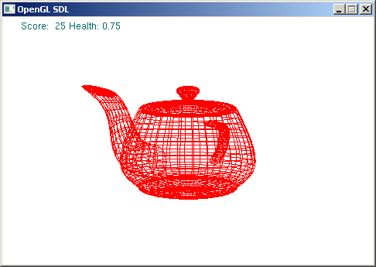
Rending a HUD (cont)
draw each line, specifying the starting position
(0, 0) is the bottom left corner
then pop the matrices in both modes – we are back in 3D
to render the current value of some variables
  int score = 25;
  float health = 0.75;
  stringstream ss;
  ss << "Score: " << score << " " << "Health: " << health << endl;
  OutputLine(5, 95, ss.str());
need to #include <string> and <sstream>

Slide 7
Animation
movement of objects around scene
the simplest method is define a variable and a rate of change
  float angle = 0.0f;
  float angleVelocity = 0.2f; // degrees per frame
then change a variable’s value by this amount each frame, in the update method
    angle += angleVelocity;
And use the variable when drawing the object
    glPushMatrix();
    glRotatef(angle, 0.0f, 1.0f, 0.0f);
    glutWireTeapot(3.0f);
    glPopMatrix();
See for example tutorial 3 – OpenGL primitives

Slide 8
Translation
you could also define a speed for object movement
  translation in x, y and z directions
  Vertex3D position = {2.5, 3, -6.2};
  Vector3D velocity = {0.01, 0.01, 0.01};
In the Update method, change the object position by this amount each frame
  position.x += velocity.x;
  position.y += velocity.y;
  position.z += velocity.z;
Translate the object to the given position before drawing it

Slide 9
Friction
rather than moving at constant speed, you could decrease the velocity slightly each frame
  velocity.x *= 0.95;
  velocity.y *= 0.95;
  velocity.z *= 0.95;
  so that the object slows down and eventually stops
could increase velocity in a given direction with arrow key

Slide 10
Collision detection - Simple bounding volumes
define a bounding sphere or box for each game object
if two bounding volumes overlap, collision has occurred
We will cover this in more detail next semester
Bounding sphere
Axis aligned bounding box (AABB)

Slide 11
Bounding spheres
collision has occurred if (distance between centres A and B)
is less than (r_{A} + r_{B})
compare distance² to avoid square root calculation
r
r
A
B
A
B
r
r
A
B
A
B

Slide 12
Axis aligned bounding boxes
y_{max}
collision has not occurred if
x_{maxA} < x_{minB}
or x_{minA} > x_{maxB}
or y_{maxA} < y_{minB}
or y_{minA} > y_{maxB}
B
y_{min}
x_{min}
x_{max}
y_{max}
A
y_{min}
x_{min}
x_{max}
y_{max}
y_{max}
B
y_{min}
A
x_{max}
x_{min}
y_{min}
x_{min}
x_{max}

Slide 13
Collision detection with the edges of the world
how would you extend this to detect collisions with the edge of your scene?
what should the response be?
remember we never change the actual coordinates of the mesh
  we just draw it in different places in the scene
the bounding volume must use the actual position of a given object and its scaled size

Slide 14
Object selection
how can we select an object in a 3D scene?
the easy way
  select via a key press
  For example, set up the keys 1 to 10 to correspond to different objects
A bit harder
  Use a menu
  Render the menu options as text on the screen
  Use a different colour for the selected menu item
  Scroll up and down using the arrow keys
  Hit enter to select the currently selected item
Even harder
  Pick the object using a mouse
  See http://www.glprogramming.com/red/chapter13.html or http://www.lighthouse3d.com/opengl/picking/

Slide 15
Placing multiple objects
usually our scene will be composed of multiple objects
we only need to specify (or load from file) one of each model
scale, rotate and translate to render it at different positions in the scene
we've already done this with pyramids and with objects loaded via the 3ds loader

Slide 16
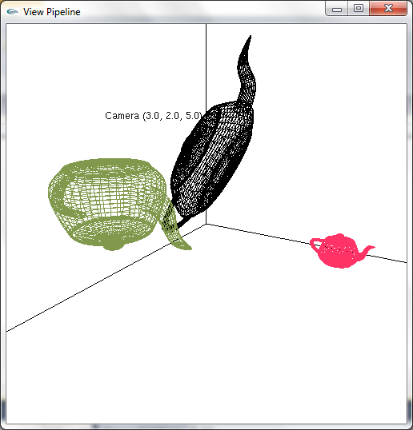
Example -Multiple teapots

Slide 17
Drawing 3 teapots
glPushMatrix();
glTranslated(2, 0, 0);
glScalef(0.25, 0.25, 0.25);
glutWireTeapot(1.0);
glPopMatrix();
glColor3f(0.5, 0.6, 0.3);
glPushMatrix();
glTranslated(-2, 0, 0);
glRotated(180, 1, 0, 0);
glutWireTeapot(1.0);
glPopMatrix();
glPushMatrix();
glTranslated(0, 1, 0);
glRotated(60, 0, 0, 1);
glScalef(1.0, 0.5, 0.5);
glutWireTeapot(1.0);
glPopMatrix();
glColor3f(1.0, 0.2, 0.4);

Slide 18
Multiple objects
in this example we hard-coded the teapot transformations
better to use variables
  so we can update them
  revenge of the spinning teapot
and/or read them from file
could declare a structure to hold all the information for one teapot instance
  colour, size, scale, position, rotation, hitPoints….

Slide 19
An array of teapots
struct teapot {
colour col;
point3D pos;
point3D rot;
point3D scale;
};
teapot theTeapots[3] =
{{ {0.0, 0.0, 0.0}, {0, 1, 0}, {0, 0, 60}, {1.0, 0.5, 0.5} },
{{1.0, 0.2, 0.4}, {2, 0, 0}, {0, 0, 0}, {0.25, 0.25, 0.25}},
{{0.5, 0.6, 0.3}, {-2, 0, 0}, {180, 0, 0}, {1.0, 1.0, 1.0}}
};

Slide 20
Drawing the teapots
for (int i=0; i < 3; i++) {
  glPushMatrix();
    glColor3fv(&theTeapots[i].col.r);
    glTranslatef(theTeapots[i].pos.x, theTeapots[i].pos.y, theTeapots[i].pos.z);
    glRotatef(theTeapots[i].rot.x, 1, 0, 0);
    glRotatef(theTeapots[i].rot.y, 0, 1, 0);
    glRotatef(theTeapots[i].rot.z, 0, 0, 1);
    glScalef(theTeapots[i].scale.x, theTeapots[i].scale.y, theTeapots[i].scale.z);
    glutWireTeapot(1.0);
  glPopMatrix();
}

Slide 21
Teapot class
a more OO approach is to create a Teapot class
then we could have an array of pointers to Teapot objects
each Teapot object knows how to draw itself
so just call this method within the main draw method
for (int i=0; i < 3; i++) {
theTeapots[i]->draw();
}

Slide 22
Teapot class
Teapot
col : colour pos : point3D rot: point3D scale: point3D
+ Teapot(c, p, r, s) + ~Teapot() +Update() +Draw()

Slide 23
What about models?
we can use the same technique for models read in from file
  for example, a cube
just read the model in once
store it in a set of arrays
or an instance of a Cube or Model class
can have an array of CubeInstance structures, or CubeInstance objects
and call the Cube draw() method instead of the glut function to draw a wire teapot

Slide 24
Models and instances
Cube
NUM_VERTS : int NUM_COL : int NUM_POLY : int vertices: point3D * colours : colour * indices : polygon *
cube(fName: string) read_file(fileName:string):int drawPolygon(a:int, b:int, c:int, d:int) draw()
CubeInstance
col : colour pos : point3D rot: point3D scale: point3D
+CubeInstance(c,p,r,s) + ~CubeInstance() +update() +draw()
*

Slide 25
Independent positioning
so far we have transformed each teapot/ model independently
by specifying its transformation between a glPushMatrix() / glPopMatrix() pair
glPushMatrix() the glPopMatrix() matrix is pushed down the stack
and a copy of it is placed on top to the stack
this copy is updated to transform the new model
glPopMatrix() the top matrix is discarded and we revert to the previous one

Slide 26
Relative positioning
sometimes we want to position objects relative to each other
planets orbit the sun, moons orbit the planets
articulated structures
  the torso bond is connected to the arm bone
  the arm bone is connected to the hand bone
transform the base object first,
then transform the next object without calling glPopMatrix() in between

Slide 27
Relative positioning pseudocode
glPushMatrix()
transform and draw the torso bone
glPushMatrix()
transform and draw the right arm bone relative to the torso bone
glPushMatrix()
transform and draw the right hand bone relative to the arm bone
glPopMatrix() //back to the right arm glPopMatrix() // back to the torso

Slide 28
Relative positioning pseudocode
now we are back to the torso transformation
glPushMatrix()
transform and draw the left arm bone relative to the torso bone
glPushMatrix()
transform and draw the left hand bone relative to the arm bone
glPopMatrix() //back to the left arm glPopMatrix() // back to the torso
// on to the legs!

Slide 29
Data structures for relative positioning
this is an example of a hierarchical object
the best way to describe the object is with a tree-like graph
then we can traverse the tree and draw each element relative to the one above
we can also traverse the tree for updates, collision detection….

Slide 30
torso
left arm
left leg
head
right leg
right arm
left hand
foot
foot
right hand
finger
finger
thumb
thumb
finger
finger
finger
finger
finger
finger

Slide 31
Scene graphs
we can extend the hierarchy to the entire scene
rooms with the scene
objects within the room
primitives within the objects…
we need to know how to construct a tree to represent the scene
and how to traverse it

Slide 32
Summary
today we have looked at some 3D techniques you can use in the assignment
tutorial
  work on assignment
  add text, animation, user interaction…
  challenge – a hiarchical scene graph

